Slide 1

Gesture Recognition
Group 31 : Arun kumar, Aswathy Baiju, Nayana Shamasunder Rao Pawar

Slide 2

Overview
Data Collection
Neural Network
PCA Dimensionality Reduction
Preprocessing pipeline
Training Data Preparation
Live Recognition System
Grid Collector Game

Slide 3
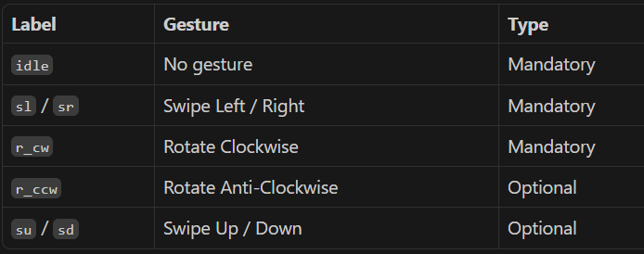
Overview and Data Collection
What We Built:
Real-time body gesture recognition via webcam controls a slideshow and a game
All ML logic (neural net, PCA, optimizers, metrics) built from scratch using NumPy only
Data Selection Criteria:
We selected upper-body joint features (shoulders, elbows, wrists) and kept only frames where their detection confidence exceeded 0.5 to ensure reliable pose data for analysis

Slide 4
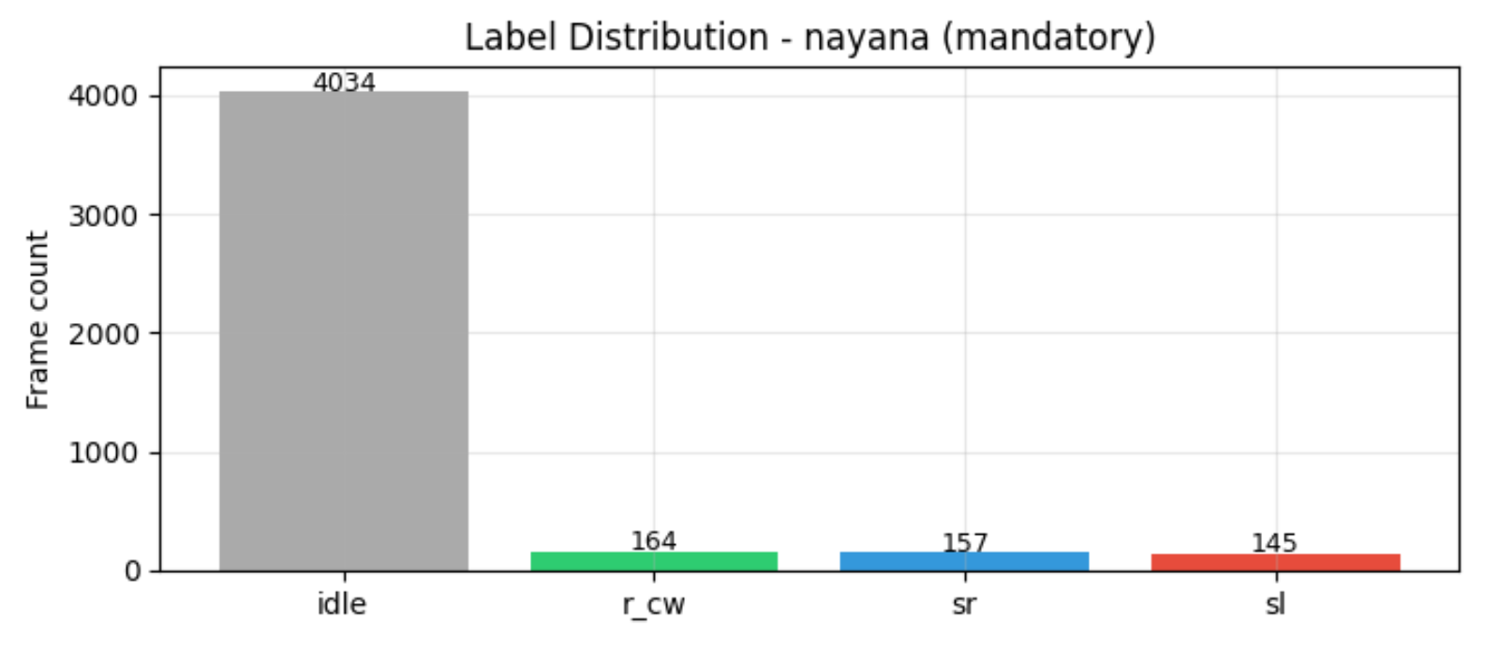
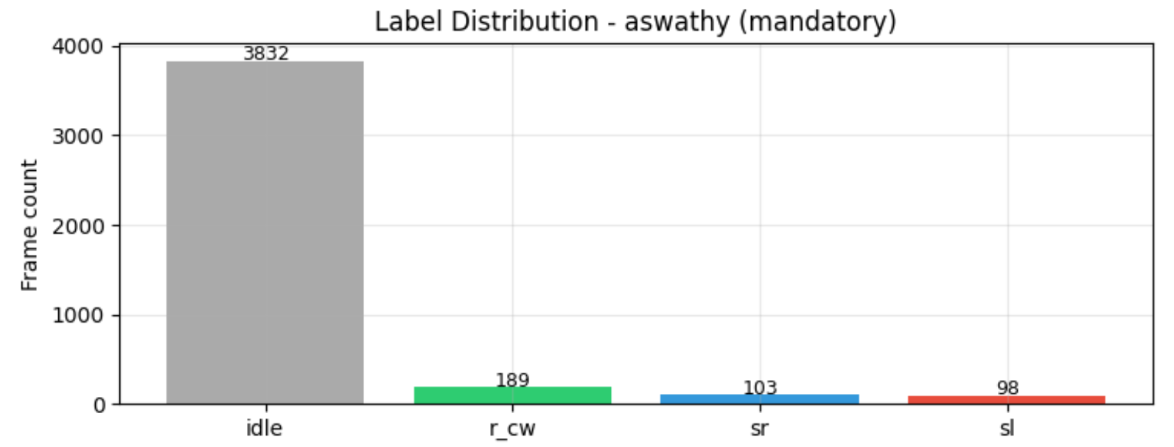
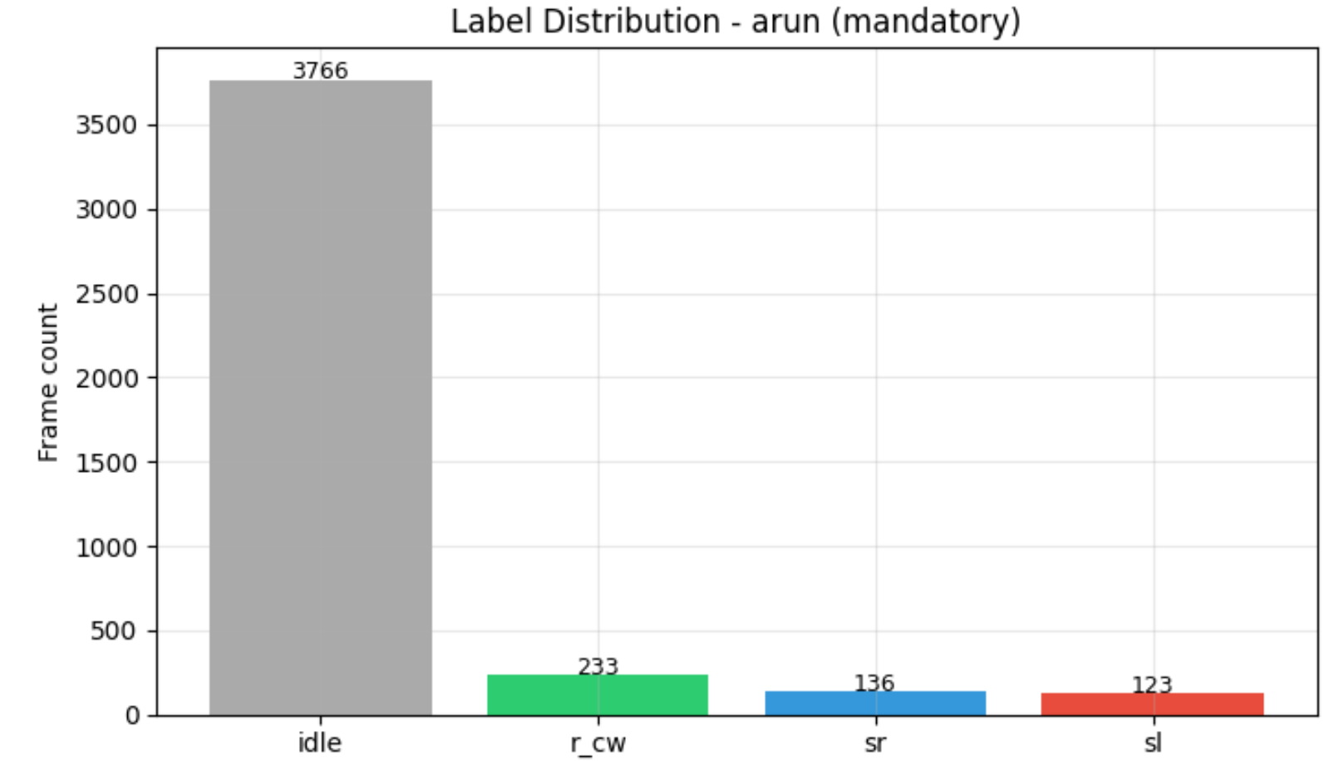
Label Distribution – per Person - mandatory

Slide 5
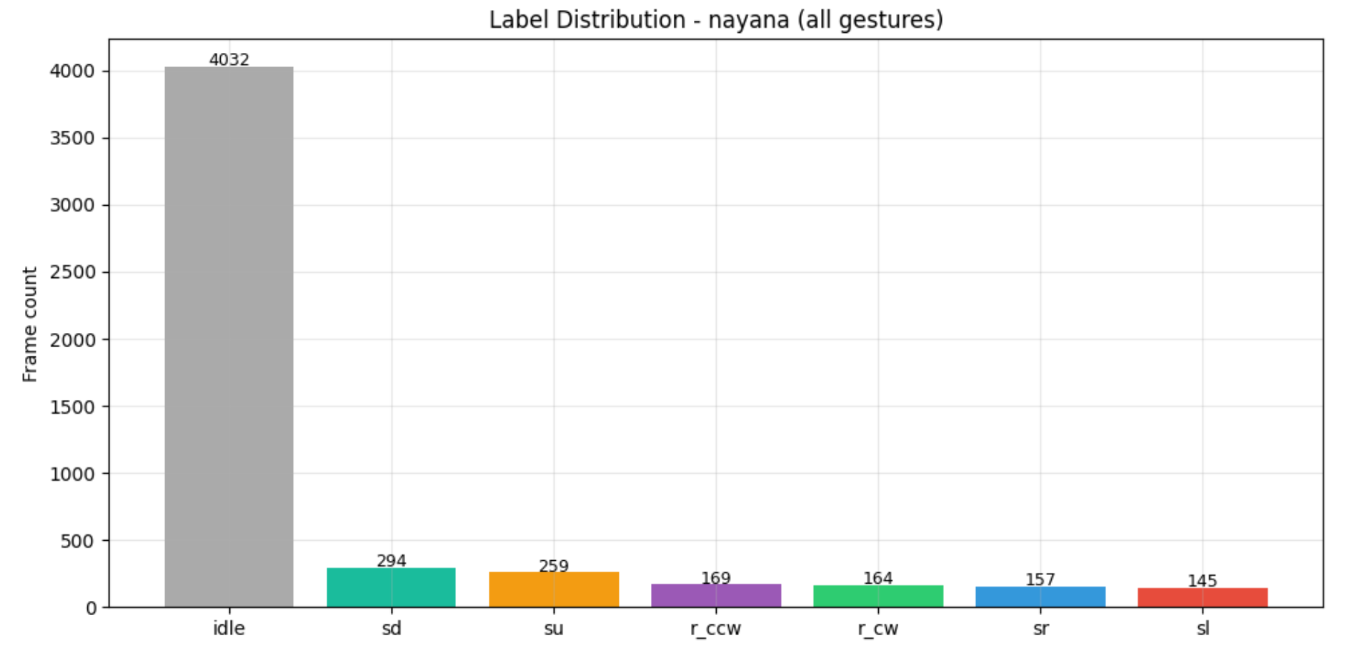
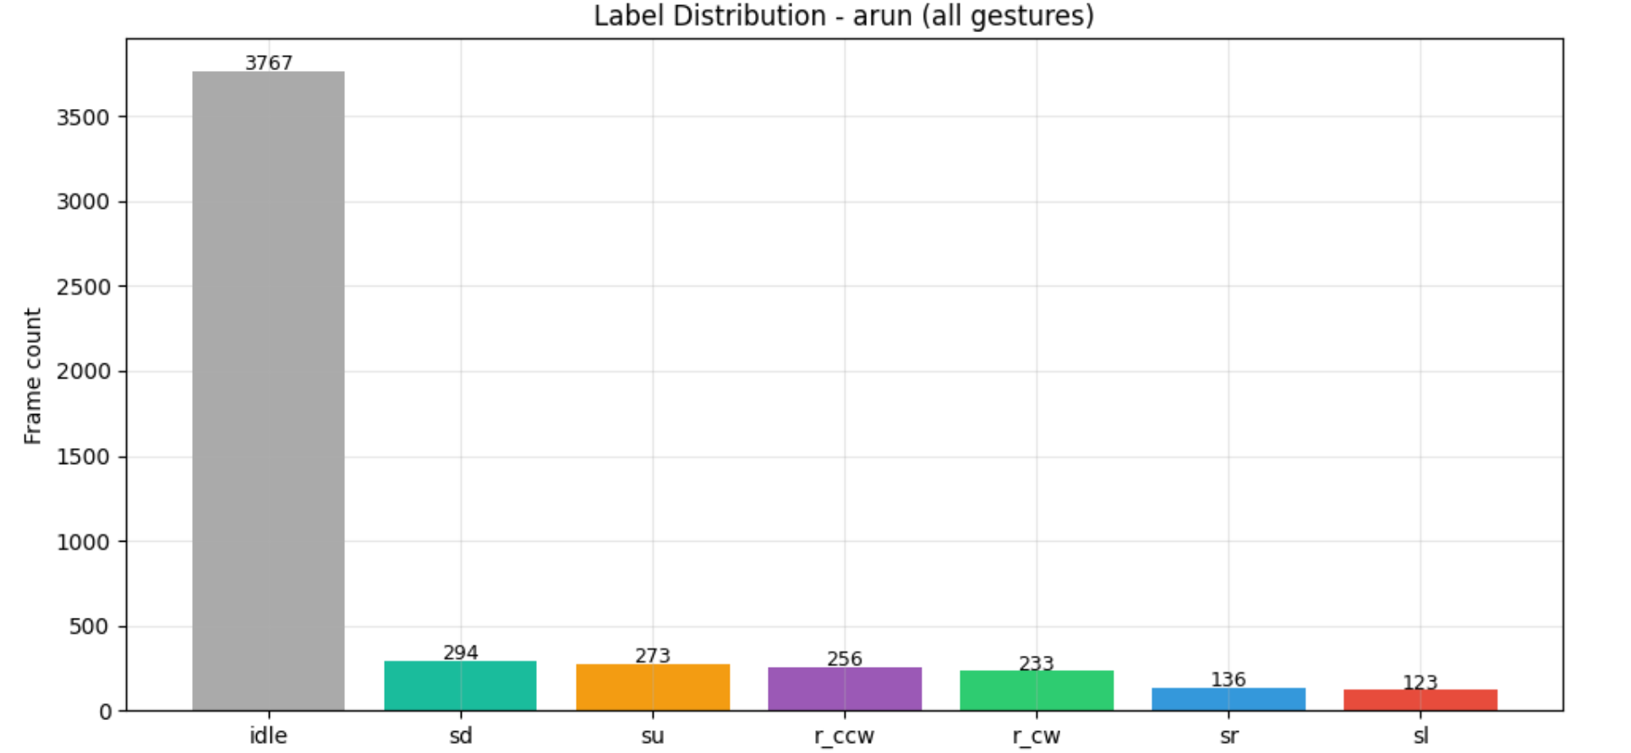
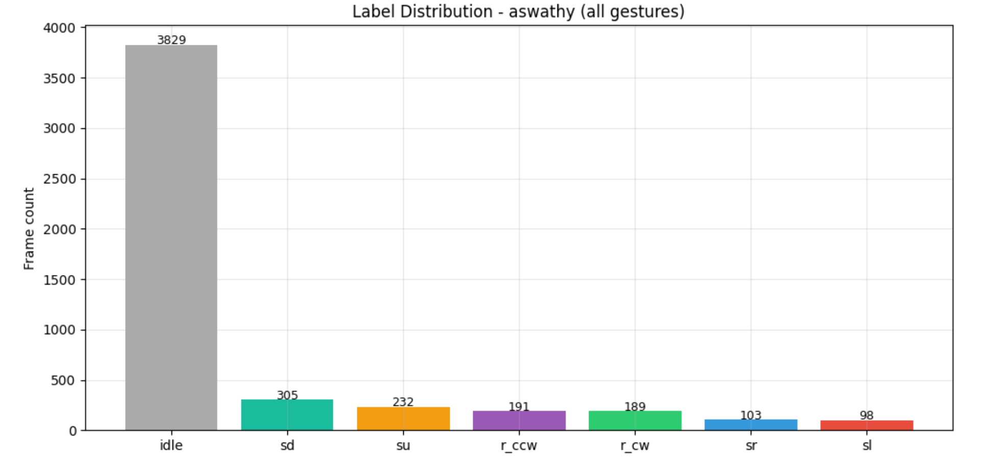
Label Distribution – per Person - optionals

Slide 6
Preprocessing Pipeline
Sl.no | Step | What happens
1 | Load | Pose CSVs loaded per person
2 | Label Map | Idle, su, sd, r_ccw, r_cw, sr, sl
3 | Confidence Filter | Any critical joint (wrists / elbows / shoulders) < 0.5 confidence → frame removed
4 | FPS Normalize | All recordings standardized to 30 FPS via integer step subsampling
5 | Chest Normalize | Keypoints shifted to shoulder midpoint, scaled by shoulder width
6 | Feature Select | Position: 45 | Velocity: 45 | Total: 90
7 | Velocity | Frame-to-frame diff → 45 velocity features · 90 features total per frame
8 | Save | {person}_preprocessed.csv, per-person design: change PERSON_NAME → run

Slide 7
Feature Engineering
Chest-Centered Normalization :
Every coordinate shifted to shoulder midpoint and divided by shoulder width
Makes features person-invariant, works regardless of body size or camera distance
Feature Selection + Velocity :
Selected 15 upper-body joints - shoulders, elbows, wrists, fingers, hips, nose etc
Each joint has x, y, z coordinates → 45 position features
Velocity = difference between consecutive frames → 45 velocity features
Total: 90 features per frame.
Output
Saved as {person}_preprocessed.csv → merged across all 3 persons for model training

Slide 8
Training Data Preparation
Sliding Window → Input Vector:
18 frames × 90 features = 1,620-dimensional input per training sample (mandatory), 1,665-dimensional input per training sample (optionals)
18 frames @ 30 FPS = 0.6 seconds of motion · Stride = 5 frames
Label taken from the center frame of each window
Class Balancing:
Idle is heavily over-represented in raw recordings
Idle windows under sampled to 2× total gesture window count
Prevents model from defaulting to idle predictions
Train / Val / Test Split:
70% train · 15% validation · 15% test — stratified per class (equal class ratios in all splits)
Random shuffle applied within each class before splitting
Standardization (fit on train only):
Per-feature z-score: mean and std computed on training set only → applied to all splits
Scaler saved to scaler_params_optionals.npz for live inference

Slide 9
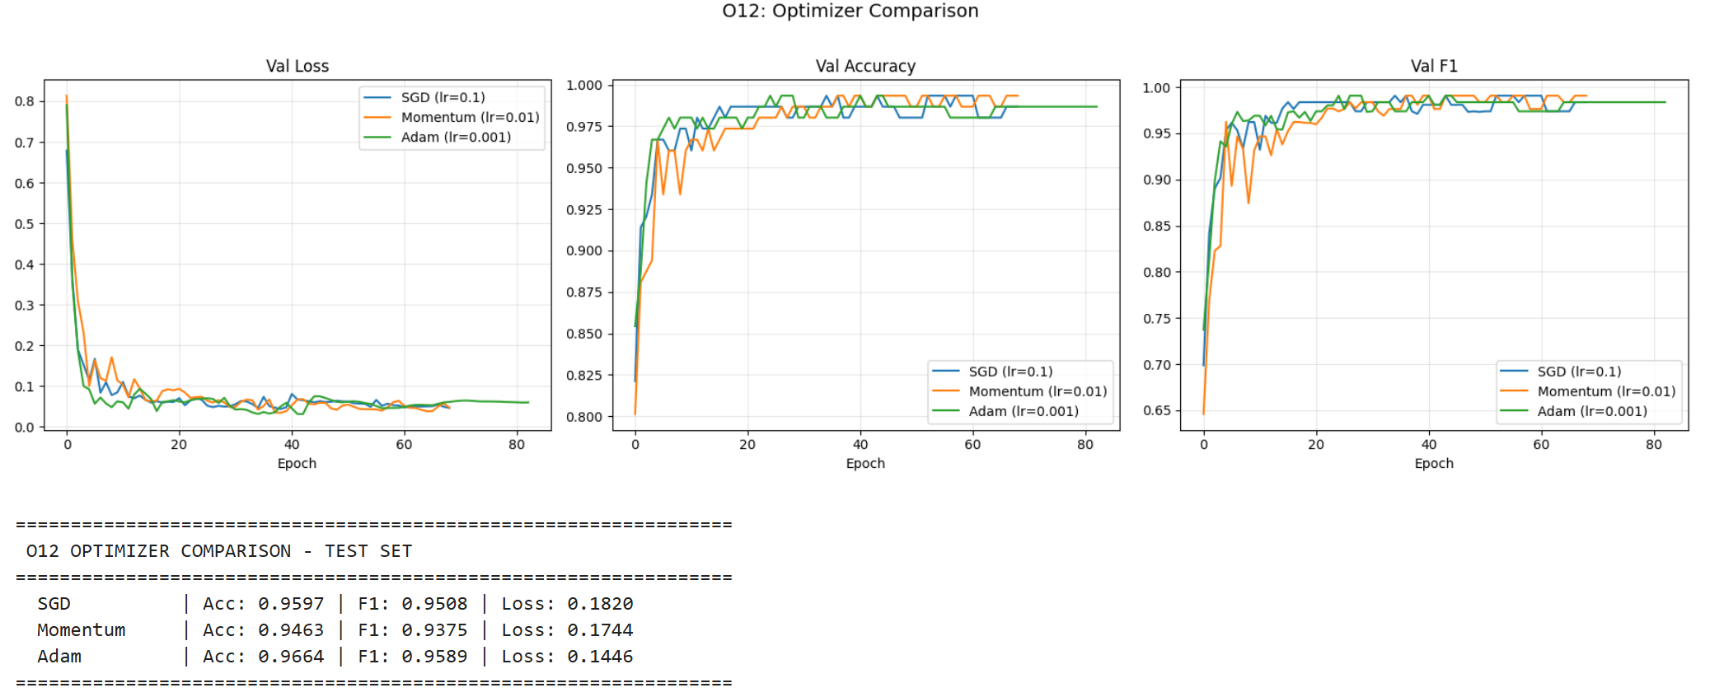
Model Selection - mandatory
Trained 3 different models – Adam, SGD, Momentum (Mandatory, 4-class)

Slide 10
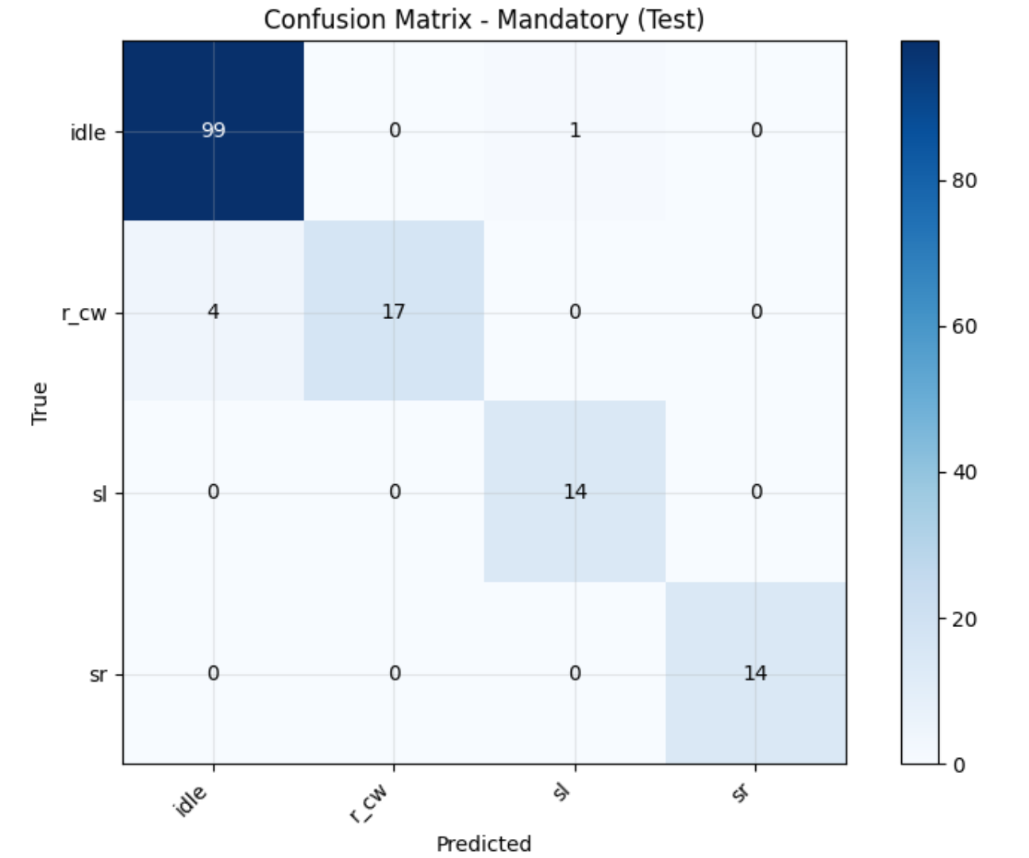
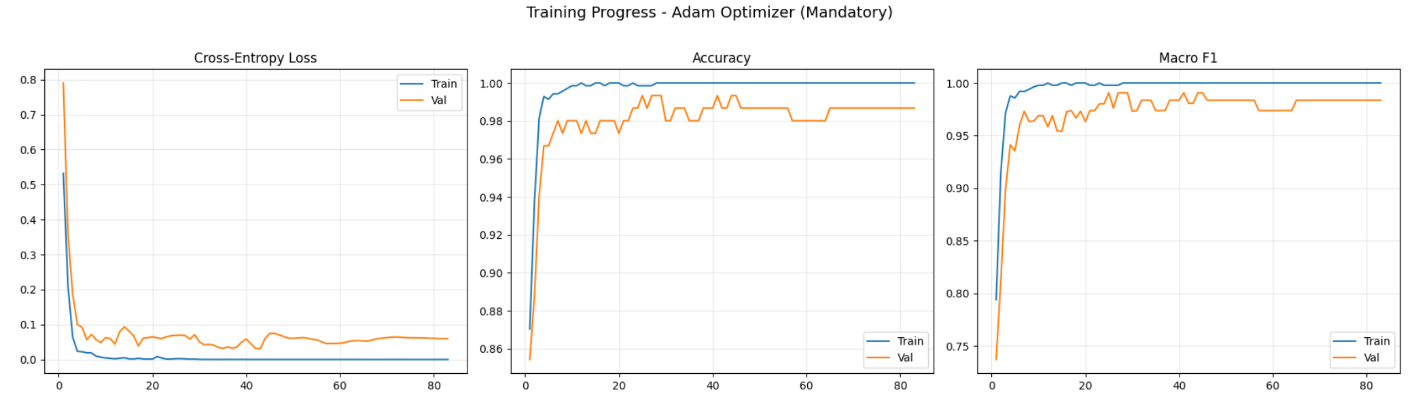
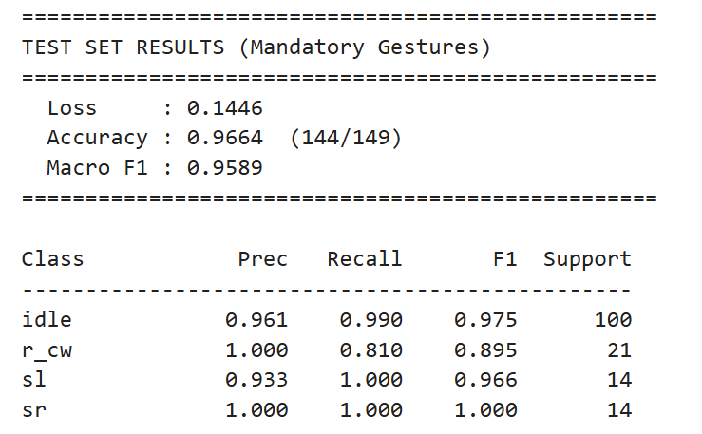
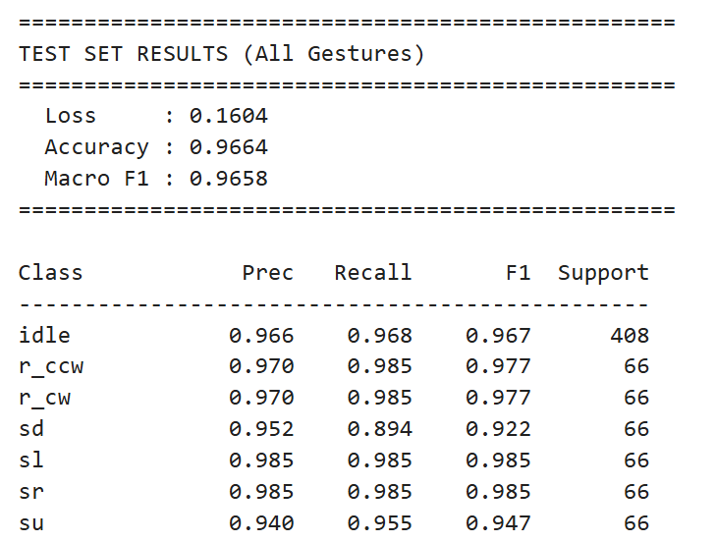
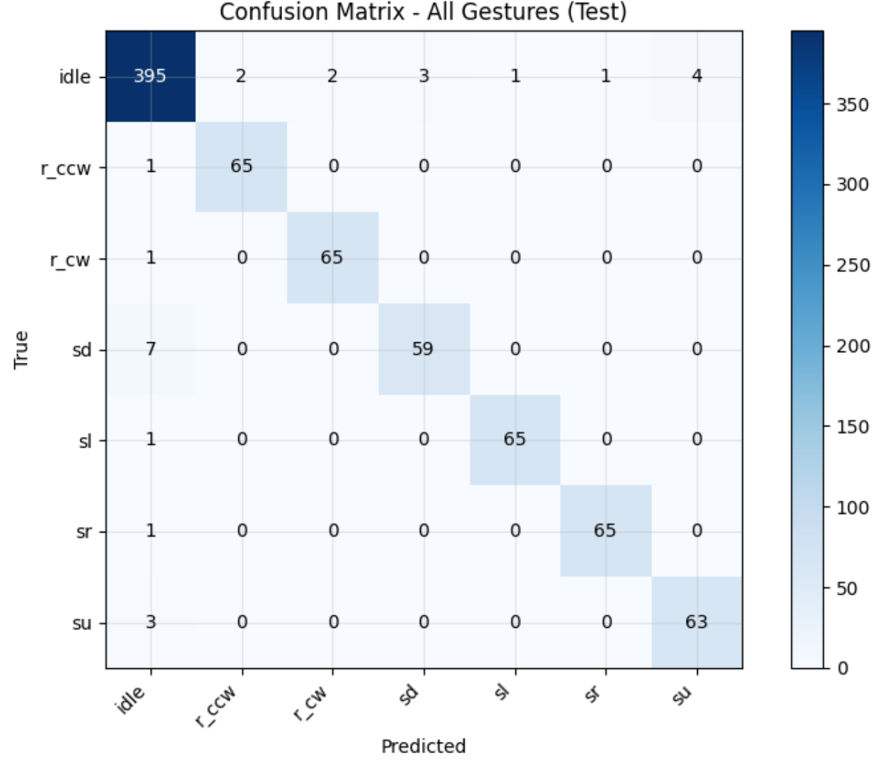
Model Selection
Selected Model – Adam

Slide 11
Adam Neural Network - justification
Adam is preferred because it yields the best generalization on all target metrics simultaneously.
Macro-F1 gain confirms stronger class-balanced behavior, critical for gesture systems where minority-motion patterns can be underrepresented.
Lowest loss indicates better probabilistic fit and confidence calibration, improving downstream thresholding/debouncing reliability in real-time inference.
Momentum did not convert its moderate loss into competitive F1/Accuracy, indicating weaker decision boundaries.
SGD is competitive but consistently inferior to Adam on both predictive quality and loss.
Deployment conclusion: mandatory inference stack should use Adam-trained parameters as the project’s final model choice.

Slide 12

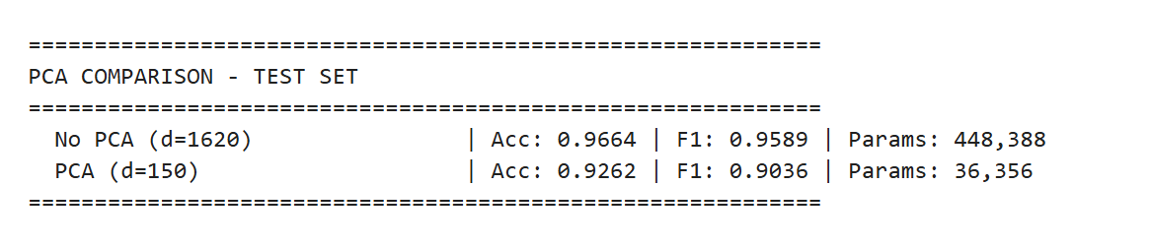
PCA Dimensionality Reduction (O2)
Why?
1620 features may contain redundant/correlated information
PCA finds directions of maximum variance, removes noise
Compared against full model:

Slide 13
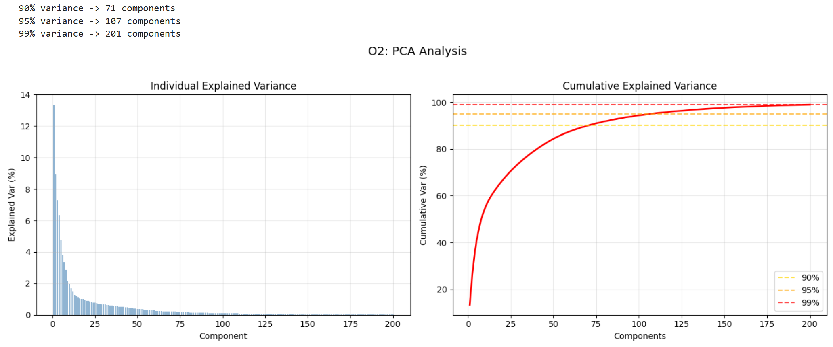
PCA Dimensionality Reduction (O2)

Slide 14
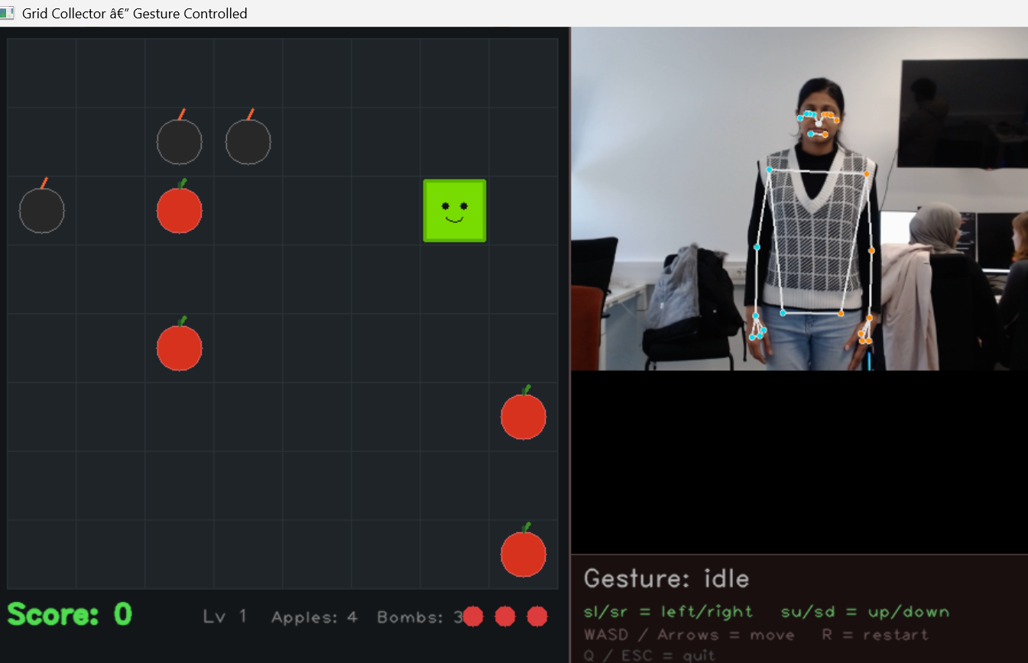
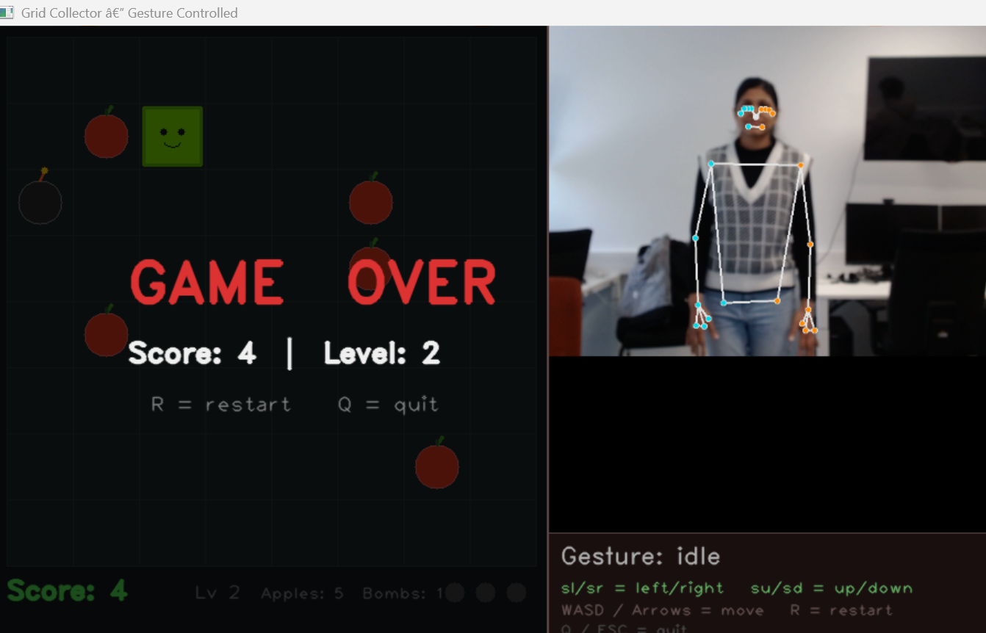
Grid Collector Game
8×8 grid — collect apples (🍎), avoid bombs (💣) — fully controlled by gestures
Gesture | Action | Game Conditions
Swipe Left / Right / Up / Down | Move player | Grab apples while avoiding bombs
Initial state | 4 apples · 3 bombs · 3 lives | Increase in difficulty with levels

Slide 15

Thank You

